Slide 1
Strategic Thinking
Bob Marshall, MD MPH MISM FAAFP
Program Director, DoD Clinical Informatics Fellowship

Slide 2
Learning Objectives
Overview of Strategic Thinking
Review the different types of thinking

Slide 3
Background
Important to have a deliberate, systematic process for making decisions and managing work to guide individuals, teams and organizations towards desired outcomes.
Those decisions have to be made with an awareness of the future and its implications, organize teams and individuals to execute those decisions and measure the results against expectations.

Slide 4
Strategic Thinking
The ability to step back from day-to-day activities and develop a long-term plan for sustained growth and development.
Strategic thinking is called for when considering organizational goals, management plans and long-term development of people.
Using strategic thinking allows for systematic and efficient strategic planning for the organization, teams and people.

Slide 5
Strategic Thinking vs. Planning
Strategic thinking and strategic planning, while complementary, are not the same thing.
F. Graetz created a model that helps to define the differences.
She said…the role of strategic thinking is "to seek innovation and imagine new and very different futures that may lead the company to redefine its core strategies and even its industry".
Strategic planning's role is "to realize and to support strategies developed through the strategic thinking process and to integrate these back into the business".

Slide 6
The Five Competencies
A systems perspective – ability to understand implications of actions
Intent focused – more determined and less distractible than others/competitors
Thinking in time – being able to hold past, present and future in mind simultaneously to create better decision making and speed implementation
Hypothesis driven – ensuring that both creative and critical thinking are incorporated into strategy creation. This competency explicitly incorporates scientific method into strategic thinking.
Intelligent opportunism – being responsive to good opportunities and not losing sight of alternative strategies as they present themselves

Slide 7
Strategic vs. tactical thinking
Strategic thinking is focused on the long term, which can vary based on the organizational and competition dynamics.
It challenges the status quo, looks at future ROI (return on investment) and takes into account the preparation/level of effort needed to reach the long-term goals.
Tactical thinking is more immediate or “in the moment”, often safe and conservative and status quo maintaining.
It looks for the immediate payoff and involves automatic and routine execution of a task.
It is the immediate “what to do and how to do it” mode of thinking.

Slide 8
Factors Driving Tactical Thinking
Culture – the biggest driver of tactical thinking, especially when strategy execution drags out and the organization misses targeted opportunities.
Lack of strategic clarity – middle managers often make tactical decisions then they do not fully comprehend the intended strategy and its implications.
Renegade managers – fairly rare; this occurs when managers make tactical decisions counter to strategy because they do not accept the strategy and have their own agenda.

Slide 9
Factors Driving Tactical Thinking
Onetime events – if only happening once, the strategic impact will not likely be a big one
Small investments – small in terms of time and resources; they can be revised later to align with strategy
Idea testing – new ideas can support the current strategy or challenge it; either way, these new ideas are good and should be nurtured. Cutting them off because they challenge/do not fit current strategy is a tactical error.

Slide 10
Analytical Thinking
Analytical thinking skills are critical because they help one to gather information, articulate, visualize and solve complex problems.
Some people make the incorrect assumption that analytical thinking and critical thinking are the same.
That is not true, and it is important to differentiate the two so one can understand when to think critically and when to think analytically.

Slide 11
Critical Thinking
When thinking critically, one makes the decision whether or not an event, object or situation appears to be right or wrong.
Once provided information, one evaluates the data and determines how best to interpret it.
Conclusions and assessments are made based on one’s perception of the information and knowledge of the world, often looking at other pieces of data that might be relevant.
Critical thinking takes facts and uses them to form an opinion or belief.

Slide 12
Analytic Thinking
Analytical thinking is used to break down complex bits of information, thinking step-by-step to develop an overall conclusion, answer or solution.
Analytical thinking uses facts to support conclusions or a train of thought. Analytical thinking may require you to think about some (or all) of the following:
Cause and effect
Similarities and differences
Trends

Slide 13
Analytic Thinking…cont
Associations between things
Inter-relationships between the parts
The sequence of events
Complex systems and how they work
Ways to solve complex problems
Steps within a process
Examples of what is happening

Slide 14
Innovative Thinking
Innovative thinking is rooted in creativity and would be considered the other side of the creative thinking “coin”.
Creativity is bringing into existence an idea that is new to you. Innovation is the practical application of creative ideas.
Creative thinking is an innate talent we were born with and a set of skills that can be learned, developed and utilized in daily problem solving.
Innovative thinking is taking the same skills as creative thinking and applying them to practical solutions.

Slide 15
Barriers
There are multiple cultural and physiological barriers to both creative and innovative thinking.
Such things as making assumptions, following the rules, over-reliance on logic and fear of failure restrict the ability of the left brain (analytic), right brain (creative), conscious and subconscious to properly collect information needed, choose and calculate which information is important, communicate those ideas to our consciousness and provide an innovative solution.

Slide 16
Creative/Innovative Thinking
One of the prime reasons to engage in creative or innovative thinking is to solve problems.
The first step in solving problems is to define them.
There are well-studied tools for defining problems.
These include the Kipling Method, the Problem Statement and the Challenge Method.
The Kipling Method (from Rudyard Kipling) uses a set of questions, the 5 W’s and the 1 H, to help trigger ideas and solve problems.

Slide 17
Creative/Innovative THinking…cont
The Problem Statement method is self-explanatory, but not easy to accomplish in many cases.
This method works when everyone identifies what the problem is for them and then collaborate/negotiate to arrive at a single best problem statement for all.
The Challenge Method works well to get people out of a thinking rut.
It is good for testing idea validity. It starts with identifying a problem or situation and then challenging it, or some component of the problem domain, with deep questions about: concepts; assumptions; boundaries; the ‘impossible’; the ‘can’t be done’; the ‘essential’; and the “sacred cows”.

Slide 18
Creating New Ideas
There are a number of well-studied tools for creating new ideas or innovating.
Three of the more common ones, out of more than 27 known tools, are: attribute listing; brainstorming; and visioning.
Attribute listing is a good technique for ensuring all possible aspects of a problem have been identified and examined.
This tool breaks the problem down into smaller and smaller bits, allowing one to see/discover the details.
The steps in attribute listing are the following: list the attributes; consider the value of each attribute; and modify the attributes to increase value, reduce negative value or create new value.

Slide 19
Brainstorming
Brainstorming, also called “Classic Brainstorming”, became popular in the 1950’s as a way to come up with new ideas.
There have been various versions developed since in an effort to overcome perceived deficiencies in “Classic Brainstorming”: Brainwriting 6-3-5; Harvey Cards; Imaginary Brainstorming; and Reverse Brainstorming.
The steps in brainstorming include the following:
Arrange the meeting for 4-8 people
Write a well-defined, clearly stated problem where everyone can see it

Slide 20
Brainstorming…cont
Ensure that everyone understands the problem/issue to be addressed
Review the ground rules (there are at least five)
Have someone (or two people) facilitate the discussion, enforce the rules and write down all ideas as they occur
Generate ideas via unstructured or structured methodology – the goal is complete participation by all in attendance
Clarify and conclude the session, combining identical ideas and obtaining consensus on the next steps/actions and a timeline

Slide 21
Visioning
The last of the three methods/tools for creative/innovative thinking is called Visioning.
It works by imagining the desired future and what the organization, team or individual is trying to achieve.
Visualize what that future state holds, and describe it to others in dynamic and emotive words (like ‘sharp’, ‘now’ and ‘value’) to paint a picture.
Phrase it in the present tense and use action verbs that talk about what is happening in the vision.
Test it against others to ensure that vision works for them as well.
Visioning works because humans are an imaginative species and are motivated by what we perceive as a possible and/or desired future.

Slide 22
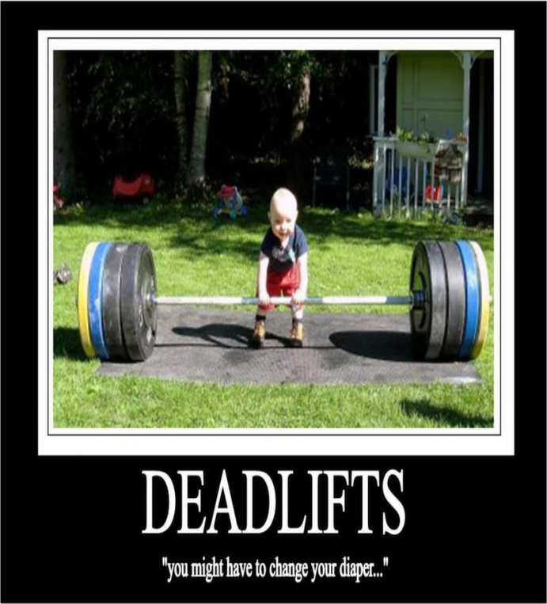
Questions
Next topic: Strategy – how does that fit with strategic thinking?

